Slide 1

Generative Models

Slide 2
Generative Models - Introduction
So far, with linear/ logistic regression, we tried to predict the probability of a given class, given a particular input
Basically, trying to build a boundary which can be used to separate different classes
Algorithms that try to learn p(y|x) directly or algorithms that try to learn mappings directly from the space of inputs X to the labels {0, 1} are called discriminative learning algorithms. Here, we’ll talk about algorithms that instead try to model p(x|y) (and p(y)).
Try to build models of what the different classes look like in terms of the input features

Slide 3
Example
Looking at elephants, we can build a model of what elephants look like. Then, looking at dogs, we can build a separate model of what dogs look like. Finally, to classify a new animal, we can match the new animal against the elephant model, and match it against the dog model, to see whether the new animal looks more like the elephants or more like the dogs we had seen in the training set.
Concretely, if y indicates whether an example is a dog (0) or an elephant (1), then p(x|y = 0) models the distribution of dogs’ features, and p(x|y = 1) models the distribution of elephants’ features.

Slide 4
Clustering is Subjective!
After modeling p(y) (called the class priors) and p(x|y), our algorithm can then use Bayes rule to derive the posterior distribution on y given x:
p(y|x) = p(x|y)p(y) p(x) .
Here, the denominator is given by p(x) = p(x|y = 1)p(y = 1) + p(x|y = 0)p(y = 0), and thus can also be expressed in terms of the quantities p(x|y) and p(y) that we’ve learned.
Actually, if were calculating p(y|x) in order to make a prediction, then we don’t actually need to calculate the denominator, since
arg max y p(y|x) = arg max y p(x|y)p(y)/ p(x) = arg max y p(x|y)p(y).

Slide 5
GDA
The Gaussian Discriminant Analysis (GDA) model, which models p(x|y) using a multivariate normal distribution.
y ∼ Bernoulli(φ)
x|y = 0 ∼ N (µ₀, Σ)
x|y = 1 ∼ N (µ₁, Σ)
Or in terms of probabilities
p(y) = φ^{y} (1 − φ)^{1−y}
p(x|y = 0) = 1/((2π)^{n/2} |Σ| ^{1/2} ) exp ( − 1/2 (x − µ₀)^{T}Σ ⁻¹ (x − µ₀) )
p(x|y = 1) = 1/ ((2π)^{n/2} |Σ|^{1/2} ) exp ( − 1/2 (x − µ₁)^{T}Σ ⁻¹ (x − µ₁) )

Slide 6
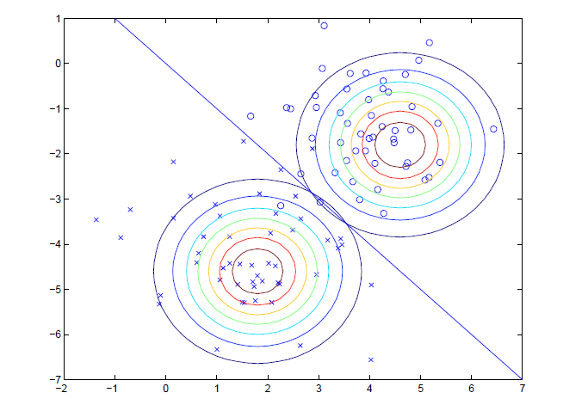
GDA
ℓ(φ, µ₀, µ₁, Σ) = Σ_{i=1}^{m} log(p(x ^{(i)} , y^{(i)} ; φ, µ0, µ1, Σ)
= Σ_{i=1}^{m} log(p(x ^{(i)}|y^{(i)} ; φ, µ0, µ1, Σ) p(y (i) ; φ)
By maximizing ℓ with respect to the parameters, we find the maximum likelihood estimate of the parameters

Slide 7
GDA vs Logistic Regression
When distribution of input features is indeed multivariate gaussian, both are maximizing the same likelihood
Logistic regression does not make any such assumptions about input features distribution
LR is more robust/ generalizable than GDA
GDA works better when inputs follow gaussian distribution

Slide 8
Naive Bayes
Makes the naive assumption that all the input features distributions are independent for a given outcome
For a motivating example, consider building an email spam filter using machine learning
We will represent an email via a feature vector whose length is equal to the number of words in the dictionary. Specifically, if an email contains the i-th word of the dictionary, then we will set x_{i} = 1; otherwise, we let x_{i} = 0.
we have to model p(x|y). But if we have, say, a vocabulary of 50000 words, then x ∈ {0, 1} 50000 (x is a 50000-dimensional vector of 0’s and 1’s), and if we were to model x explicitly with a multinomial distribution over the 2⁵⁰⁰⁰⁰ possible outcomes, then we’d end up with a (2⁵⁰⁰⁰⁰−1)-dimensional parameter vector.
To model p(x|y), we will therefore make a very strong assumption. We will assume that the xi ’s are conditionally independent given y.

Slide 9
Naive Bayes
p(x₁, . . . , x₅₀₀₀₀|y) = p(x₁|y)p(x₂|y, x₁)p(x₃|y, x₁, x₂)· · · p(x₅₀₀₀₀|y, x1, . . . , x₄₉₉₉₉)
= p(x₁|y)p(x₂|y)p(x₃|y)· · · p(x₅₀₀₀₀|y)
= ∏^{n}_{i=1} p(xi |y)
to make a prediction on a new example with features x, we then simply calculate
p(y = 1|x) = p(x|y = 1)p(y = 1) /p(x)
= [∏^{n}_{i=1}p(x_{i} |y = 1) p(y = 1)] /[ ∏^{n}_{i=1}p(x_{i} |y = 1) p(y = 1) + ∏^{n}_{i=1}p(x_{i} |y = 0) p(y = 0)]

